Slide 1


Introduction To
Data Science
Introduction To Data Science
“Hiding within those mounds of data is the knowledge that could change the life of a patient, or change the world”

Slide 2

Supervised Learning
Introduction To Data Science

Slide 3
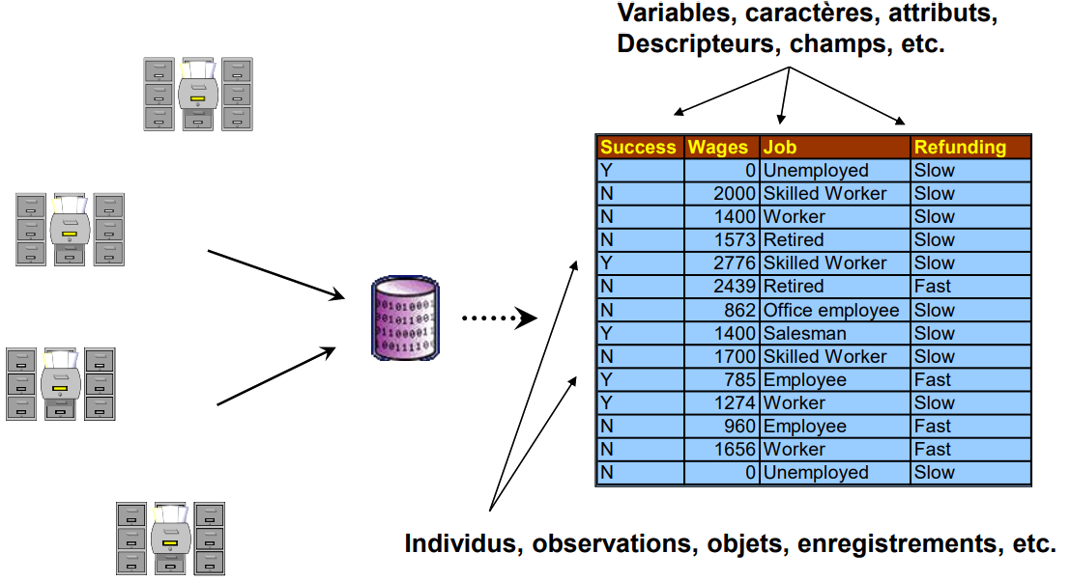
Data Tables
Introduction To Data Science
Variables, characters, attributes, Descriptors, Fields, etc…
Individuals, Observations, Objects, Lessons, etc

Slide 4
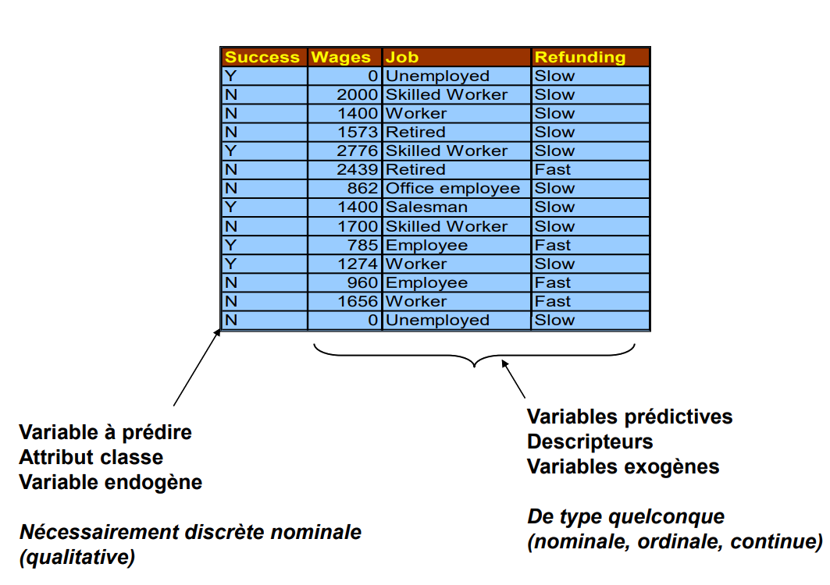
Variable Status
Introduction To Data Science
Predictable Variables
Class Attributes
Endogenous Variables
Necessarily discrete nominal
(qualitative)
Predictive variables
Descriptors
Exogenous variables
Of any type
(nominal, ordinal, continuous)

Slide 5
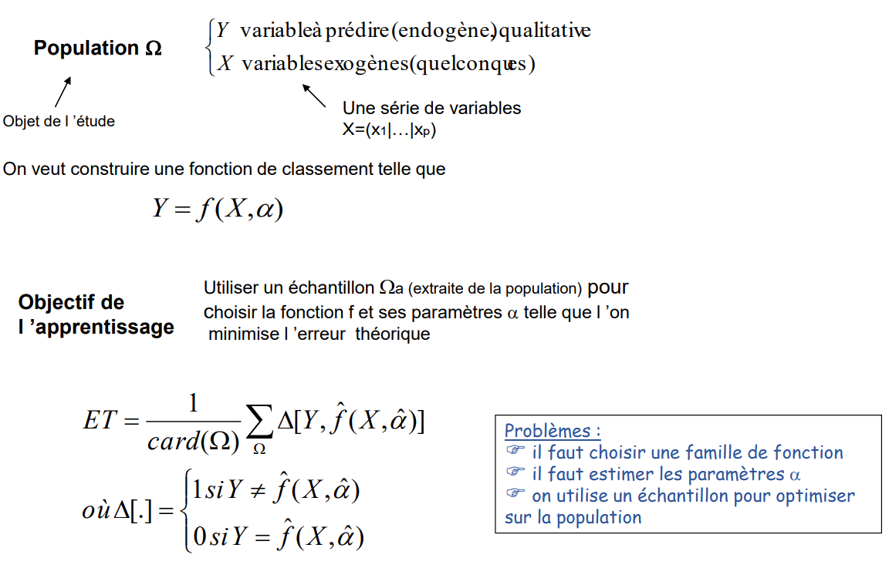
Principles of supervised learning
Introduction To Data Science
X variable to be predicted (endogenous), qualitative
Y exogenous variables (any)
A Series of variables
Object of study
We want to construct a ranking function such that
Objective of the
learning
Use a sample
(extracted from the population)
To choose the function f and its parameters such that we minimizes the theoretical error
Problems:
you must choose a family of functions
we must estimate the parameters
we use a sample to optimize on the population
Where

Slide 6
Bayesian learning
Introduction To Data Science
(special case of the 2-class problem - Positive vs. Negative)
2-step learning from the data:
estimate the assignment probability P(Y / X)
predict [Y = +] if P(Y = + / X) > P(Y = - / X)
Remarks:
P(Y = + / X) is, depending on the case, called "score" or "liking": it is the "propensity to be a positive".
This assignment method minimizes the prediction error -- it is a special a special case of the cost of misallocation

Slide 7
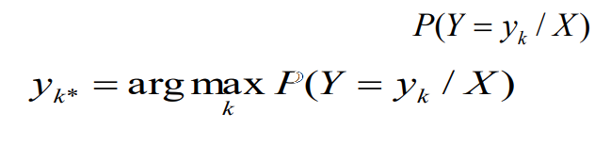
Bayesian learning
Introduction To Data Science
(K Class Generalisation)
2-step learning from the data:
estimate the probability of assignment
predict
Remarks:
When the Xs are discrete, we can deduce a logical model of assignment.
If X1 = ? and X2 = ? and X3 = ? ... Then Y = ?
(Premiss)
(Conclusion)

Slide 8
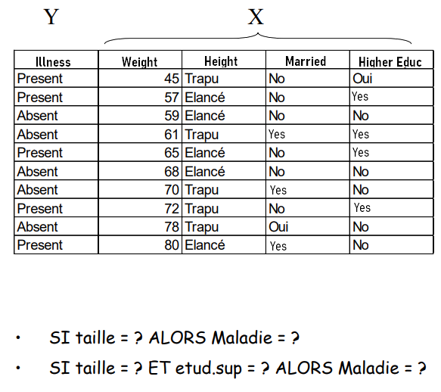
Bayesian learning
Introduction To Data Science
(Example)
If Height = ? Then illness = ?
If Height = ? And Higher Educ = ? Then illness = ?

Slide 9
Advantages and disadvantages of the full Bayesian model
Introduction To Data Science
Advantages :
Optimal, it minimizes the theoretical error
Disadvantages :
No direct solution for continuous descriptors (discretization or distribution assumption)
No selection and evaluation of descriptors (individually or groups of variables - thus no selection)
As soon as the number of descriptors increases :
Problem of calculability
Huge number of operations, ex. 10 descr. Binary => 2^10 rules
Problem of data fragmentation
Lots of boxes with 0's, unreliable estimates
This approach is not usable in practice!

Slide 10
Assessment of The learning
Introduction To Data Science
The model expresses “knowledge”
Explanation: understand the causality to better exploit it
Validation: the expert can evaluate the relevance of the expertise
Improvement: the expert can intervene to adjust the calculated parameters (e.g., discretization limits)
In learning, to be able to test several tracks (addition of variables, test combination of variables, modification of parameters, etc.)
In classification, assign a label to a new individual
Ease of updating the model (cf. the notion of incrementality)
Evaluate the accuracy (quality) of the model during its future use
Understanding
Speed
Accuracy

Slide 11
Assessment of The learning Confusion Matrix
Introduction To Data Science
Predicted
Some indicators:
True positives VP = a
False positives FP = c
Error rate = (c+b) / n
Sensitivity = Recall = VP rate = a/(a+b)
Accuracy = a/(a+c)
FP rate = c/(c+d)
Specificity = d/(c+d) = 1 - FP rate
 | + | - | Total
+ | a | b | a+b
- | c | d | c+d
Total | a+c | b+d | n
Observed

Slide 12
Evaluation - The Costs of Misallocation
Introduction To Data Science
Comparison of two learning methods
Predicted
Predicted
 | + | - | Total
+ | 40 | 10 | 50
- | 20 | 30 | 50
Total | 60 | 40 | 100
 | + | - | Total
+ | 20 | 30 | 50
- | 0 | 50 | 50
Total | 20 | 80 | 100
Observed
Observed
Calculate synthetic indicators and compare
Additional information The misclassification cost matrix
Predicted
 | + | -
+ | 20 | 30
- | 0 | 50
Average cost of misallocation (of which the error rate is a special case)
Observed

Slide 13
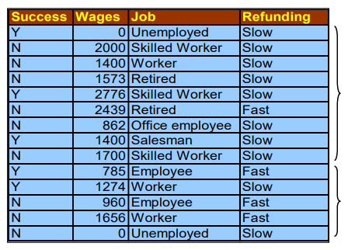
Assessment - The Learning & Testing Principle
Introduction To Data Science
Comparison of two learning methods
Problem: a file cannot be both judge and jury In this case, the indicators calculated are said to be "resubstitution indicators" We know that they are biased -- too optimistic
Random subdivision
Learning sample Used to build the model 70%
Test sample Used for model evaluation 30%
Recall, accuracy, error rate...

